Slide 1
Debre Markos University College of natural and computational Sciences Department of Statistics
2. SUMMARIZING OF DATA

Slide 2
Objectives
At the end of this chapter students will be able to:
Define measure of central tendency
Explain properties of measure of central tendency
Summarize an aggregate of statistical data by using single measure
Memorize the computational formula for different measure of central tendency
Know different positional measures such as quartiles, deciles and percentiles with their interpretation.
determine the scatter/dispersion of the data from MCT

Slide 3
2.1. Measure of Central Tendency Introduction
The most important objective of statistical analysis is to determine a single value for the entire mass of data
Describes the overall level of the group of observations and can be a representative of the whole set of data
There are several such measures, but here we shall discuss the most commonly used measures of central tendency. This includes: mean, median and mode.

Slide 4
Introduction………
Objectives of measures of central tendency
To get a single value that represent(describe) characteristics of the entire data
To summarizing/reducing the volume of the data
To facilitating comparison within one group or between groups of data
To enable further statistical analysis

Slide 5
Introduction………
The Summation Notation ( )
Statistical Symbols: Let a data set consists of a number of observations, represents by x₁ , x₂ ,..., xn where n (the last subscript) denotes the number of observations in the data and x_{i} is the i^{th} observation. Then the sum

Slide 6
Introduction………
X - Whole set of numbers
x_{i} - Specific score in a set of numbers
n - Number in subset (group)
For instance a data set consisting of six measurements 21, 13, 54, 46, 32 and 37 is represented by x₁ , x_{2,} x₃ , x_{4,} x₅ and x₆
where x₁ =21, x₂ =13,x₃ =54 , x₄ =46, x₅ =32 and x₆ =37
Their sum becomes
= 21+13+59+46+32+37=208.

Slide 7
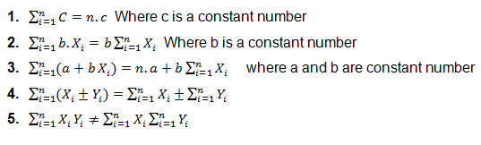
Introduction……… Some Properties of the Summation Notation

Slide 8
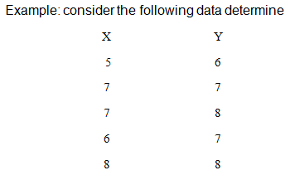
Introduction………

Slide 9
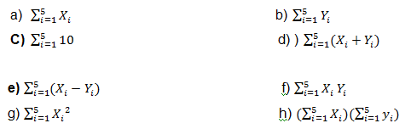
Introduction………

Slide 10
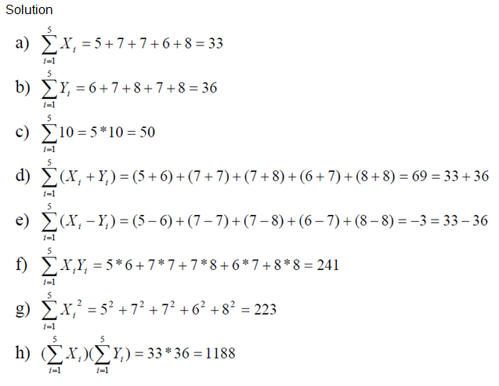
Introduction………

Slide 11
Introduction………
Important Characteristics of a Good Average
A typical average should posses the following:
• It should be rigidly defined.
• It should be based on all observation under investigation.
• It should be as little as affected by extreme observations.
• It should be capable of further algebraic treatment.
• It should be as little as affected by fluctuations of sampling.
• It should be ease to calculate and simple to understand

Slide 12
Mean
Among the types of means we discuss four of them
Which are suitable for a particular type of data
These are
Arithmetic mean
weighted mean
geometric mean and
harmonic mean.

Slide 13
Arithmetic mean The arithmetic mean, usually abbreviated to ‘mean’ is the sum of the observations divided by the number of observations.

Slide 14
A.M…….
Suppose the data are given in the form of ungrouped frequency distribution with frequencies f₁, f₂, f_{3…}f_{n} associated with the values of the variable x₁, x₂, x₃…x_{n} resp.
The sum of all values equals f₁x₁+f₂x₂+f₃x₃+f₄x₄+………….+f_{n}x_{n} and the total number of items is obviously f₁+f₂+f₃+….+f_{n}

Slide 15
A.M
Arithmetic mean of grouped data
In the ungrouped case, the exact value of each item is known.
However, the data is grouped such that we are given frequency distribution of finite sized class intervals we do not know the values of every item.
Moreover, the observations in each class are represented by the class mark of the class interval.

Slide 16

A.M
For a frequency distribution (grouped) with k classes in which the j^{th} class has the class mark of x_{j} with corresponding frequency f_{i}, j=1, 2, 3…k.
where,
k = the number of class intervals
x_{i} = the mid-point of the i^{th} class interval
f_{i} = the frequency of the i^{th} class interval

Slide 17
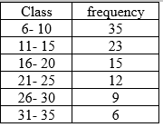
Example:
Calculate the mean for the following age distribution.

Slide 18
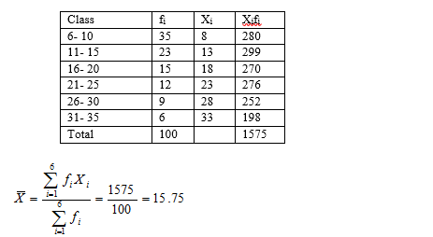
Solution

Slide 19
A.M ……..
Combined mean:“If we have arithmetic means X̅₁, X̅₂… X̅_{n} of n groups having the same unit of measurement of a variable, based on n₁, n_{2…} n_{n} observations respectively,
we can compute the combined mean of the variant values of the groups taken together from the individual means by the formula

Slide 20
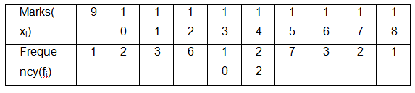
Class exercise
The net weights of the contents of five pc screen selected at random from the production line are (in grams); 85.4,85.3,84.9,85.4 and 85. What is the arithmetic mean weight of the sample observation?
Calculate the mean of the marks of 57 students given below

Slide 21
Properties of A.M
The mean can be used as a summary measure for both discrete and continuous data, in general however, it is not appropriate for either nominal or ordinal data.
For a given set of data there is one and only one arithmetic mean.
Algebraic sum of the deviations of the given values from their arithmetic mean is always zero.
The arithmetic mean is greatly affected by the extreme values.
In grouped data if any class interval is open, arithmetic mean cannot be calculated.
If we transform the original observation x₁, x₂, x₃… x_{n} to y₁=ax₁±b, y₂=ax₂±b… y_{n}=ax_{n} ± b, then the mean of the transformed values, is given by ȳ=ax̄±b
Easy to calculate and understand

Slide 22
Properties A.M….
If a wrong figure has been used when calculating the mean the correct mean can be obtained with out repeating the whole process using:
Example: An average weight of 10 students was calculated to be 65.Latter it was discovered that one weight was misread as 40 instead of 80 kg. Calculate the correct average weight.
Ans. 69kg

Slide 23
Classwork
1. The mean of n Tetracycline Capsules X₁, X₂, …, Xn are known to be 12 gm. New set of capsules of another drug are obtained by the linear transformation Y_{i} = 2X_{i} – 0.5 ( i = 1, 2, …, n ) then what will be the mean of the new set of capsules?
2. In a class there are 30 females and 70 males. If females averaged 60 in an examination and boys averaged 72, find the mean for the entire class.

Slide 24
Weighted mean
In the computation of arithmetic mean we had given equal importance to each observation
Sometimes the individual values in the data may not be equally importance.
When this is the case, we assigned to each weight which is proportional to its relative importance and calculate the weighted mean.
The weighted mean of a set of values x₁, x₂, x₃…x_{n} with corresponding weights w₁, w₂…w_{n} denoted by x̄_{w} and computed by:

Slide 25
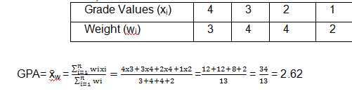
The calculation of cumulative grade point average (CGPA) is a good example of weighted mean.
E.g. If a student scores “A “in a 3 credit hours course ,”B” in a 4 credit hours course ,”C”In another 4 credit hours course and “D” in a 2 credit hours course and the numerical values of the letter grades are A=4,B=3 C=2,D=1,compute his /her GPA for the semester.
Solution

Slide 26
Geometric mean(G.M)
If the observed values are measured as ratios, proportions or percentages, Geometric mean gives a better measure of central tendency than other means.
The Geometrical mean of n positive values is defined as the n^{th} root of their product .
That is, if all the given observations x₁, x₂, x₃…x_{n} are positive, then G.M=(x₁.x₂.x₃………….x_{n}) ^{1/n}
In case the observed values x₁,x₂,x₃,……..,x_{n} have the corresponding frequencies f₁, f₂, f₃…f_{n}
Then G.M=( x₁^{f1}. x₂^{f2}. x₃^{f3}. x₄^{f4}.………….. x_{n}^{fn} )^{1/n}

Slide 27
In case of grouped data, class marks of the class interval are considered as x_{i} and can be used as such
G.M = (m₁^{f1}. m₂^{f2}..………….. m_{n}^{fn} ) ^{1/n} , Where n is the sum of frequency
Example1: The man gets three annual raises in his salary. At the end of first year he gets an increase of 3%, at the end of the second year he gets an increase of 6% and at the end of the third year he gets an increase of 9% of his salary. What is the average percentage increase in the three periods?
Solution: G.M = (1.03X1.06X1.09.)^{1/3} = 1.0631=>1.0631-1=0.0631
Therefore, the average percentage increase is 6.31%.

Slide 28
Example2: Compute the Geometric mean of the following values. 2, 8, 6, 4, 10, 6, 8, 4
Solution: Total number of observation is 8. We use geometric mean for grouped data formula to calculate Geometrical mean
G.M = (2^{f1}.4^{f2}.6^{f3}.8^{f4}.10^{f5})^{1/8} = (737280)^{1/8} = 5.41
Geometric mean is computed through logarithm.
We formulate the above formula interims of logarithm (with base ten).
From the above formula when reduced to its logarithmic form, it will be Log (G.m) =log (x₁.x₂.x₃…x_{n})^{1/n}
=1/n log (x₁. x₂.x₃…. x_{n}) =1/n (logx₁+logx₂+…+logx_{n})
So G.M =antilog (1/n (logx₁+logx₂+…+logx_{n}))

Slide 30
G.M………
Geometric mean formula for frequency distribution
Log (G.m) = log (x₁^{f1}. x₂^{f2}. x₃^{f3}. x₄^{f4}… x_{n}^{fn}) ^{1/n}
=1/n log (x₁^{f1}. x₂^{f2}. x₃^{f3}. x₄^{f4}… x_{n}^{fn})
=1/n (logx₁^{f1}+logx₂^{f2}+logx₃^{f3}+logx₄^{f4}…+logx_{n}^{fn})
=1/n(f₁logx₁+f₂logx₂+f₃logx₃+…+f_{n}logx_{n})
So G.M =antilog (1/n(f₁logx₁+f₂logx₂+f₃logx₃+…+f_{n}logx_{n}))

Slide 31
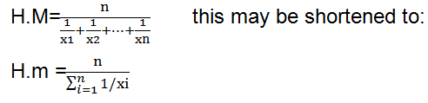
Harmonic mean(H.M) Another important mean is the harmonic mean, which is suitable measure of central tendency when the data pertains to speed, rates and time. Let x₁,x₂,x₃,……..,x_{n} be n variant values in a set of observation, then the harmonic mean is given by

Slide 32
H.M………
The following is a good example in which the application of harmonic mean is appropriate.
Example A motorist travels for three days at a rate (speed) of 480km/day. On the first day he travels 10 hours at a rate of 48km/h, on the second day 12hours at a rate of 40km/h, on the third day 15hours at a rate of 32km/h. what is the average speed?
The average speed can be calculated by calculating the harmonic mean of the three rates.
H.M= 3/((1/48)+(1/40)+(1/32))= 38.92 so the required average speed =38.92km/h

Slide 33
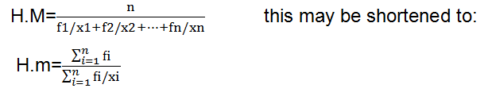
H.M……… If the data are arranged in the form of frequency distribution in which an observation x_{i} has frequency f_{i} (i=1, 2, 3…k), the harmonic mean is given by

Slide 34
Mode
Any observation of a variable at which the distribution reaches a peak is called a mode.
Most distributions encountered in practice have one peak and are described as uni-modal.
E.g. Consider the example of ten numbers
19 21 20 20 34 22 24 27 27 27
In the above data set, the mode is 27
The mode of grouped data, usually refers to the modal class, (the class interval with the highest frequency)
Having located the modal class of the data, the next problem is to interpolate the value of the mode with in this “modal class”.

Slide 35
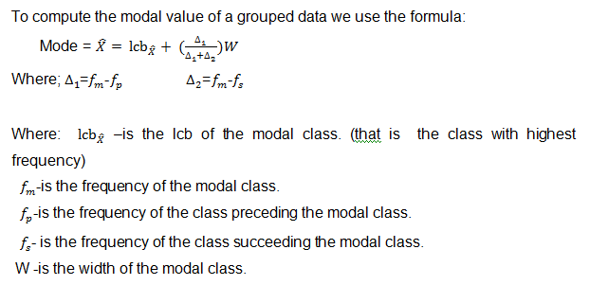
Mode………

Slide 36
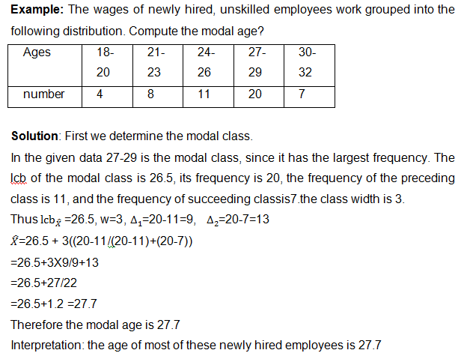
Mode………

Slide 37
Mode………
Properties of mode
The mode can be used as a summary measure for nominal, ordinal, discrete and continuous data, in general however, it is more appropriate for nominal and ordinal data.
It is not affected by extreme values
It can be calculated for distributions with open end classes
Sometimes its value is not unique
The main drawback of mode is that it may not exist

Slide 38
Class exercise
The proportion of gender in the class is as follows
Gender male female
Frequency 38 30
2. The student quiz score out of 5 is as follows
5 4 4 5 5 3 4 5 3 4 3 3
Find mode for Que.1&2

Slide 39
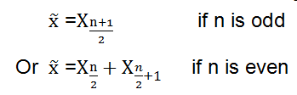
Median The median is the middle value in the sorted list Median of ungrouped data : The median is found by arranging the data in order of magnitude. The median is then the value of the middle term Let x₁, x₂, x₃… x_{n} be n ordered observations. Then median value is given by:

Slide 40
Median………
Example 1: Suppose the sales commission of 15 representatives were as follows:
23, 16, 31, 77, 21, 14, 32, 6, 155, 9, 36, 24, 5, 27, 19
Solution: Placing the data in order of magnitude, we have 5, 6, 9, 14, 16, 19, 21, 23, 24, 27, 31, 32, 36, 77, and 155
The value of the middle term is the 8th value that is 23
Example 2: If there are six items with values.
25, 29, 30, 32, 35, 65 what is the median value ?
The median is obtained by determining the arithmetic mean of the two central observations 30 & 32. Median = (30+32)/2=31

Slide 41
Median………
In some cases ungrouped data may be given in a frequency distribution form.
Now consider the case were the data are arranged in the form of frequency distribution.
Suppose the ordered values x₁, x₂, x₃…x_{k} have their corresponding frequencies f₁, f₂…f_{k}
Construct the less than cumulative frequency
less than cumulative distribution tells us the number of values that below or above the specified value of the observations.
The variant value corresponding to less than cumulative frequency is the median.

Slide 42
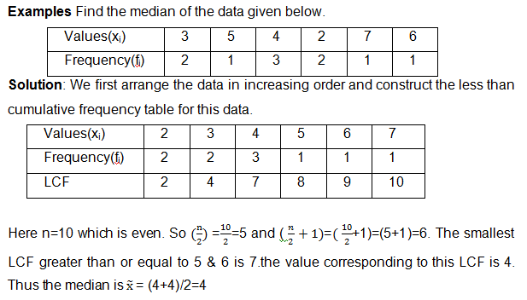
Median………

Slide 43
Median………
Median of grouped data: in the grouped data, the raw data have been organized in to a frequency distribution of finite class interval
Some of the information is not identifiable, that is we do not know the value of every item
But we can locate the middle observation by dividing that the total number of observations (n) by 2.
The class corresponding to the smallest LCF that is ≥ n/2 is called the median class.

Slide 44
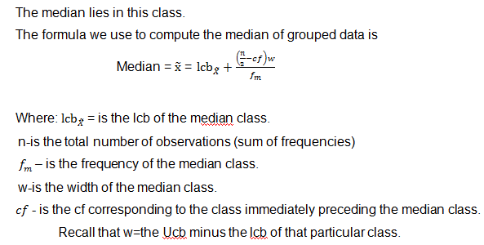
Median………

Slide 45
Median………
Steps of calculating median in the case of grouping
Construct the LCF table.
To determine the median class divide the total number of observations by2 and then search for the smallest LCF which is ≥ n/2.
To apply median for grouped data formula

Slide 46
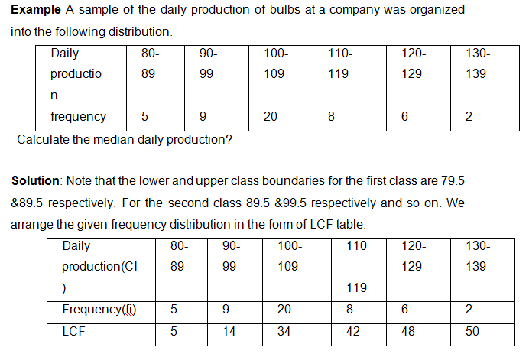
Median………

Slide 47
Median………
To obtain the median class we divide 50 by 2.
Thus n/2=50/2=25. The smallest lcf which is ≥25 is 34. Thus, the median class is 100-109 which is the class corresponding to 34. So the 25th bulb is in the 100-109 class.
Now to use the above formula we need to know Lcb, w, f_{m} and lcf_{p} for the class immediately proceeding to the median class, Lcb =99.5, w=10, f_{m}=20 lcf_{p}=14
Median= lcb+((n/2)-cf))w/fm = 99.5+((50/2)-14))10/20 = 105
Therefore the median daily production is 105.

Slide 48
Median………
Properties of median
The median can be used as a summary measure for ordinal, discrete and continuous data, in general however, it is not appropriate for nominal data.
There is only one median for a given set of data
Median is a positional average and hence it is not affected by extreme values (It is robust or resistant to extreme values)
Median can be calculated even in the case of open end intervals
It is not a good representative of data if the number of items is small

Slide 49
Class exercise compute median
The following data is the number of PC infected by virus with the category of their severity, patients who treated at Debre Markos University.
Category Moderate Mild Severe
Frequency 20 10 12
The student test score out of 10 is arranged in the following ungrouped frequency distribution table
Mark 8 4 5 7 9 10
Frequency 6 7 5 11 11 6

Slide 50
Measures of Non-central Locations
Which is divides a given set of data in to equal subdivision
They are averages of position (non-central tendency)
Some of these are quartiles, deciles and percentiles.

Slide 51
Quartiles
Quartiles: are values which divide the data set in to four equal parts
The first quartile is also called the lower quartile and the third quartile is the upper quartile. The second quartile is the median. Qi=(i(n+1)/4)^{th} observation
If (i(n+1)/4)^{th} observation is in decimal Qi= (whole number)^{th} observation + decimal((whole number + 1)^{th} observation-(whole number)^{th} observation)
Q1
Q2
Q3
25% below and 75% above
50% below and 50% above
75% below and 25% above

Slide 52
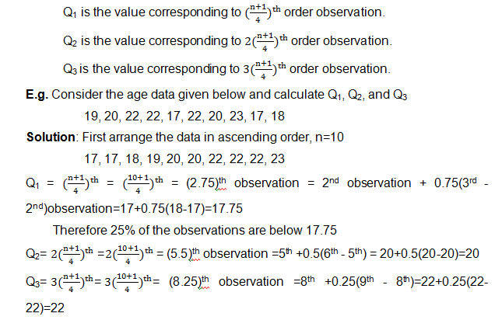
Quartiles………

Slide 53
Quartiles………
Calculation of quartiles from grouped data
For the grouped data, the computations of the three quartiles can be done as follows:
Calculate (i x n)/4 and search for the minimum lcf which is ≥ (i x n)/4 i=1,2,3
The class corresponding to this lcf is called the i^{th} quartile class. This is the class where Q_{i} lies.
The unique value of the i^{th} quartile (Q_{i}) is then calculated by the formula

Slide 54
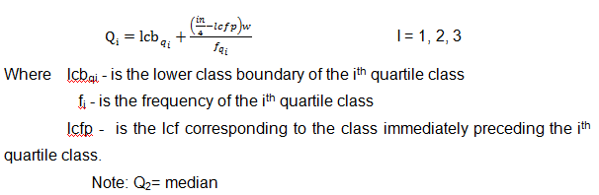
Quartiles………

Slide 55
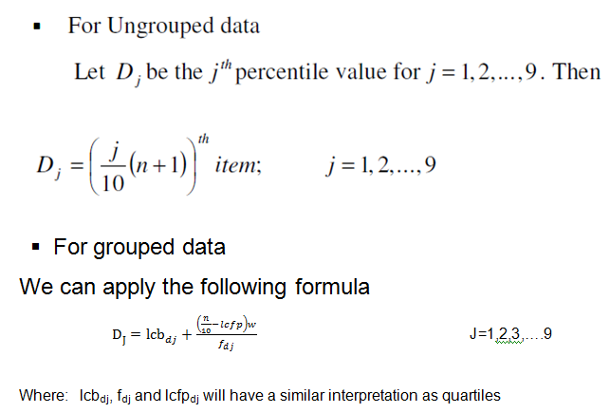
Deciles Deciles : are the nine points, which divide the given ordered data into 10 equal parts.

Slide 56
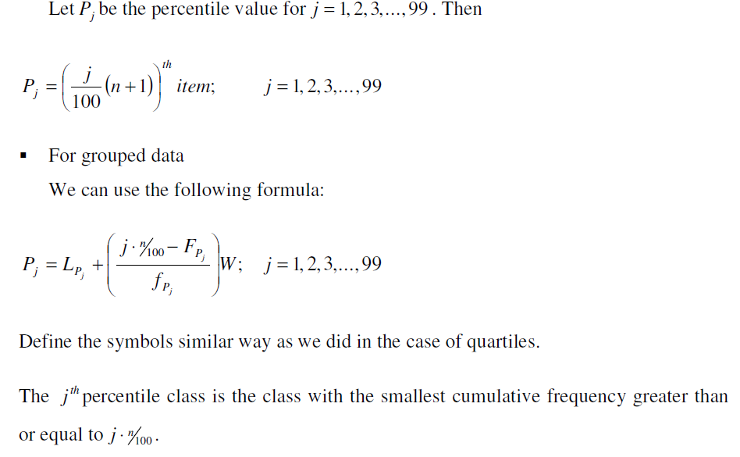
Percentiles Percentiles: are values which divide the data in to one hundred equal parts

Slide 57
Example
Calculate Q1 , Q2 , Q3 , D5 , D7 , P50 , P80 for the following tables.
Value (x) 0 1 2 3 4 5 6 7 8
Frequency (f) 1 9 26 59 72 52 29 6 1
Solution
The given data is measured and it is arranged in an increasing order. So we need to construct only the cumulative frequency table before calculating the required values.
Value (x) 0 1 2 3 4 5 6 7 8
Frequency (f) 1 9 26 59 72 52 29 6 1
Cumulative Frequency (LCF) 1 10 36 95 167 219 248 254 255
The total number of observations is 255. Clearly then the median is 4 because

Slide 58
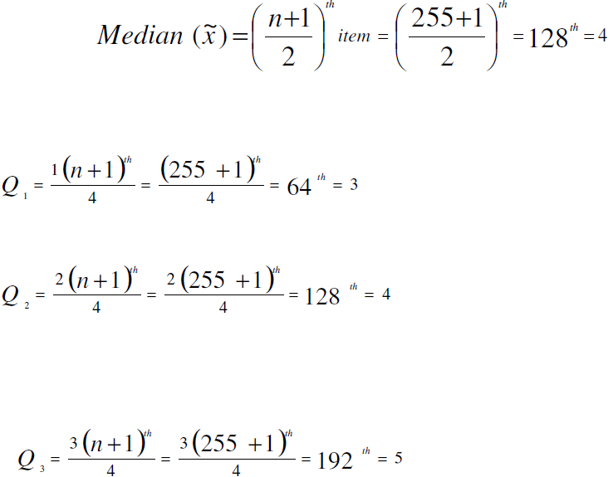
Example………

Slide 59


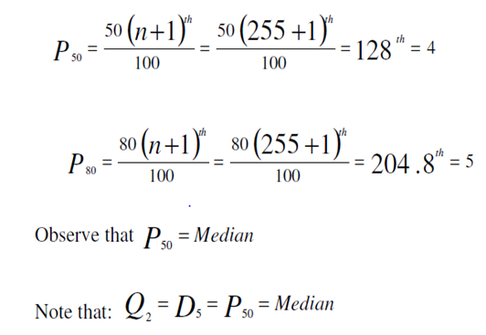

Slide 60
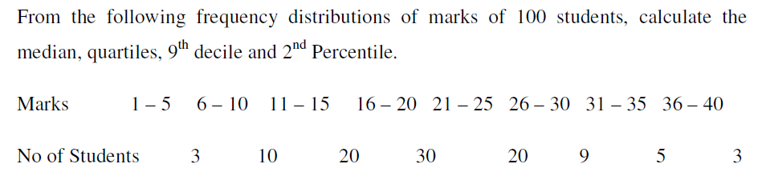
Class exercise

Slide 61
Measure of Variation

Slide 62
Objectives
After studying this lesson, you should be able to:
• Explain the meaning of measures of dispersion.
• State and explain the objective of measures of dispersion.
• Explain the difference b/n measures of central tendency and variation.
• Interpret the measures of dispersion
• Compare the variations between two distributions using coefficient of variations.
• Apply the Z-score to find out the relative standing of values.

Slide 63
Introduction
Measures of central tendency locate the center of the distribution.
But they do not tell how individual observation are scattered on either side of the center.
The spread of the observations around the center is known as dispersion or variability.

Slide 64
Objective of measure of variation
To measure reliability of the average being used.
To control variation in a product.
To compare variability among two or more groups.

Slide 65
Absolute and Relative measures
Measure of dispersion can be classified as absolute and relative form.
Absolute measures of dispersion- are expressed in concrete units. That is units in terms of which the data have been expressed.
Relative measure of dispersion: It is a pure number and is usually expressed in a percentage form.
Relative measures are used for making comparisons b/n two or more distributions.

Slide 66
Types of measure of variation
Range: is the difference b/n the highest and smallest observation.
For ungrouped data
R= X_{L}-X_{s}
where X_{L}- is the largest observation
X_{S}- is the smallest observation
For grouped data
R= UCB_{L}-LCB_{F}
where UCB_{L}- is the upper class boundary of the last class
LCB_{F}- is the lower class boundary of the first class

Slide 67
Range………
It is the simplest to compute, it takes into account only the two extreme values of the data.
The other values have no role to play. Because of this range is considered as rough measure of variation.

Slide 68
Relative range
Range is a measure of absolute dispersion and cannot be used for comparing variability of two distributions expressed in different units.
Measurements made in Kg are not comparable with dispersion measured in centimeters.
The solution is to use relative range or any other relative measure of variation.
Relative Range= Range/( X_{L}+X_{s})

Slide 69
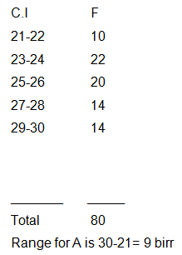
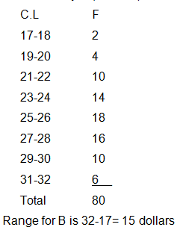
Relative range……… Example: consider weekly earning of workers in two laboratories of the same type.
Laboratory A (in birr)
Laboratory B (in dollar)

Slide 70
Relative range………
We cannot use range for comparing the variability because the units are different
We have to use relative range.
R.R for laboratory A= Range/( X_{L}+X_{s})= 9/( 30+21)=0.1764
R.R for laboratory B= Range/( X_{L}+X_{s})= 15/( 32+17)=0.306
Therefore, the variation is high in the case of laboratory B.

Slide 71
Range………
Advantage of range
It is easy to calculate
It is easy to understand
Limitation of range
It can be affected by extreme values
It cannot be computed when the distribution has open-ended classes.
It cannot be total into account the entire set if data.
It does not tell anything about the distribution of values in series relative to measure of central tendency.

Slide 72
Variance
The variance is a measure of dispersion.
The variance use the distance of our values from their mean.
It tells us something about the scatter of scores around the mean.
If the values are grouped near to the mean the variance will be little.

Slide 73
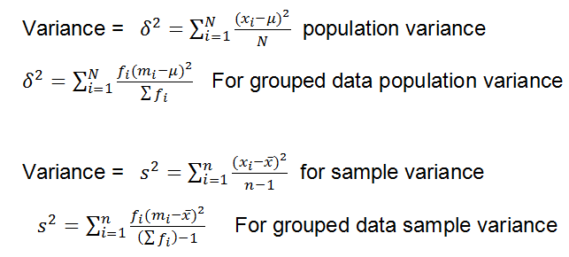
Variance………

Slide 74
Variance………
steps used to calculate the variance:
Find the arithmetic mean.
Find the difference between each observation from the mean.
Square these differences.
Sum the squared differences.
Divide the number (from step 4 above) by the number of observations

Slide 75
Standard Deviation
There is a problem with variances. Recall that the deviations were squared.
That means that the units were also squared.
To get the units back the same as the original data values, the square root must be taken.

Slide 76
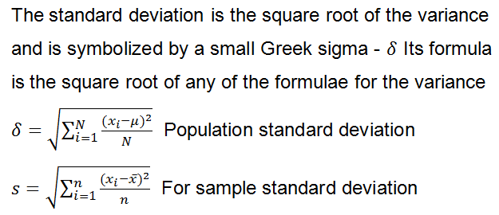
Standard Deviation………

Slide 77
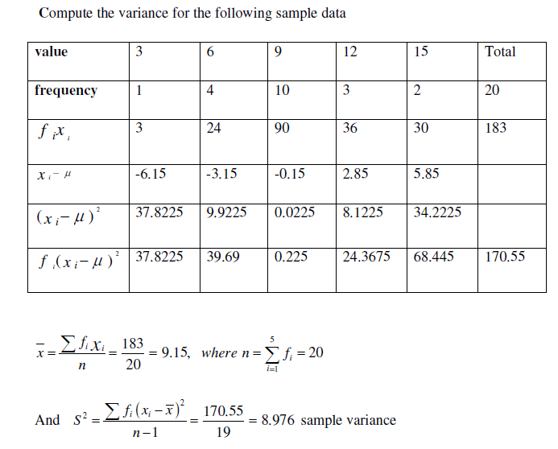
Example

Slide 78
Coefficient of variation
Coefficient of variation is used in such problems where we want to compare the variability of two or more different series.
Coefficient of variation is the ratio of the standard deviation to the arithmetic mean, usually expressed in percent.
A distribution having less coefficient of variation is said to be less variable or more consistent or more uniform or more homogeneous.

Slide 79
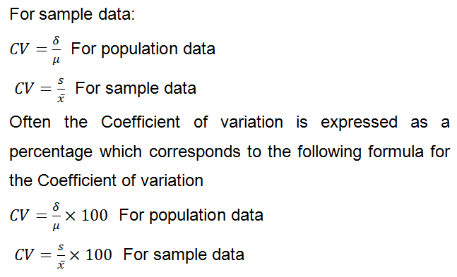
Coefficient of variation………

Slide 80
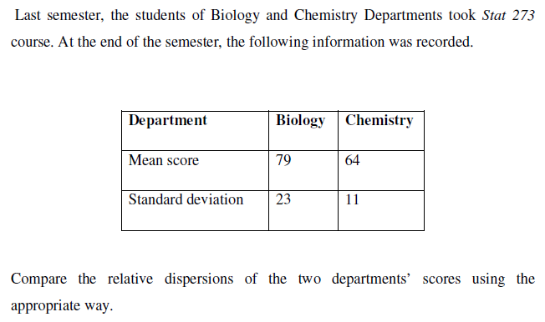
Example

Slide 81
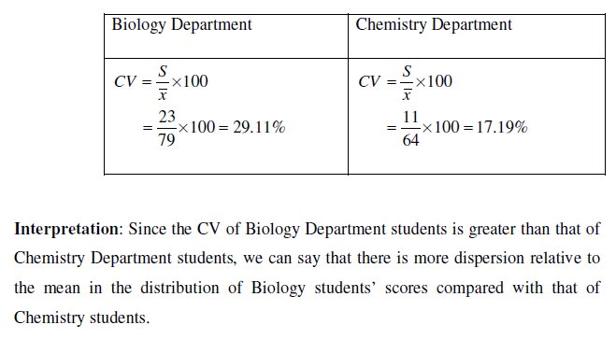
Solution

Slide 82
Standard Scores (Z-Scores)
A standard score is a measure that describes the relative position of a single score in the entire distribution of scores in terms of the mean and standard deviation.
It also gives us the number of standard deviations a particular observation lie above or below the mean.

Slide 83
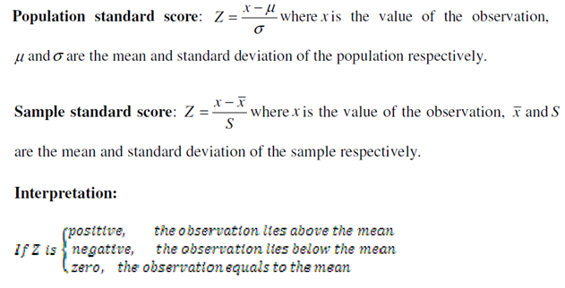
Standard Scores (Z-Scores)………

Slide 84
Example
1. Two sections were given an exam in a course. The average score was 72 with standard deviation of 6 for section 1 and 85 with standard deviation of 5 for section2. Student A from section 1 scored 84 and student B from section 2 scored 90. Who performed better relative to his/her group?

Slide 85
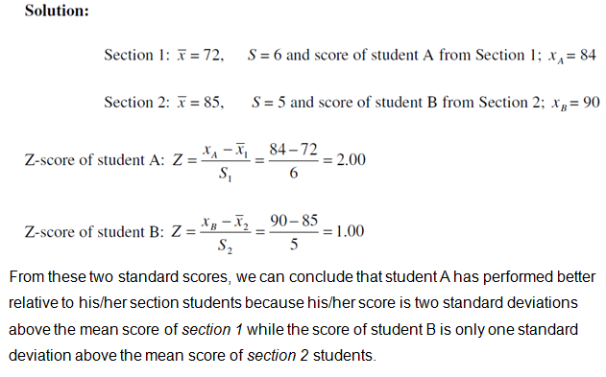
Example………

Slide 86
Thank You for Your Attention!

